Slide 1
Satakunta University of Applied Sciences (SAMK)

Slide 2
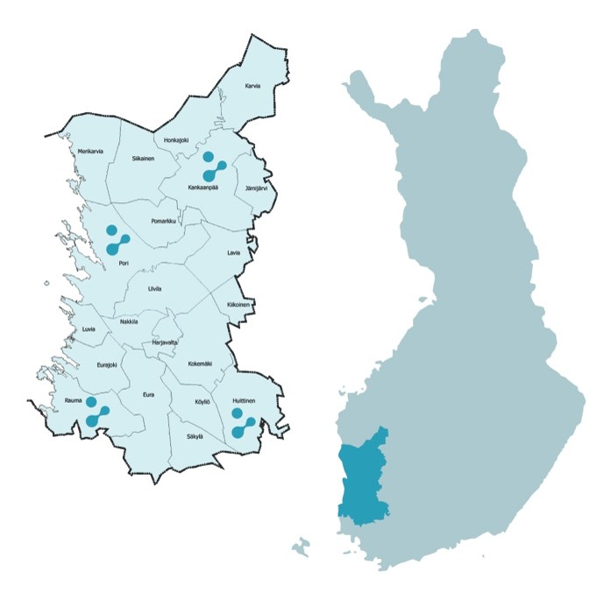
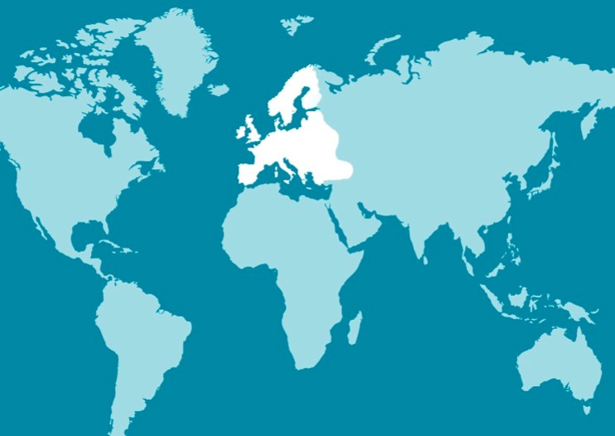
SAMK operatES on the west coast of Finland

Slide 3
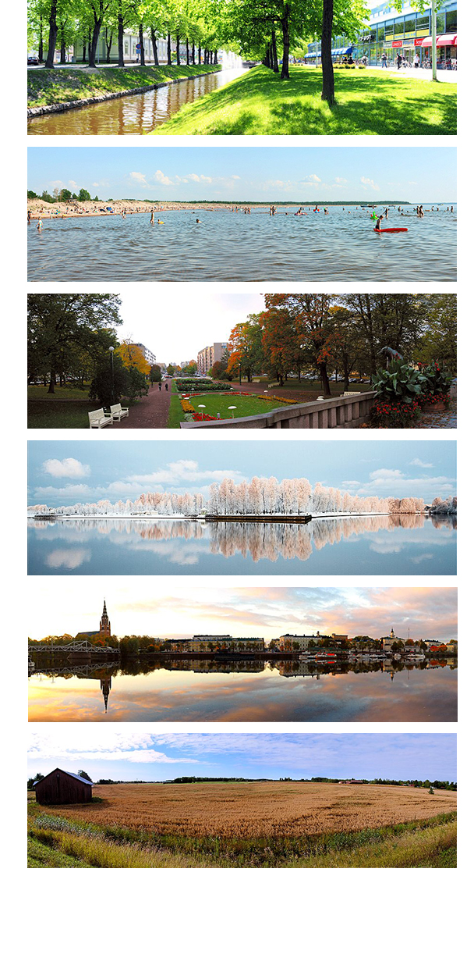
Satakunta region in Finland
One of Finland’s 18 regions
The most industrialised region in Finland
Branches of industry
  Energy
  Metals
  Offshore
  Robotics
  Food processing
  Chemicals

Slide 4

SAMK FACTS
Towns: 4 (Pori, Rauma, Huittinen and Kankaanpää)
Campuses: 4
Degree students: 5,500
Staff members: 400, with PhD or Licentiate degrees: 73
The 4 faculties implement
Education
R&D activities
Business operations
SAMK is a limited liability company, owned by the municipalities and local business organizations.

Slide 5
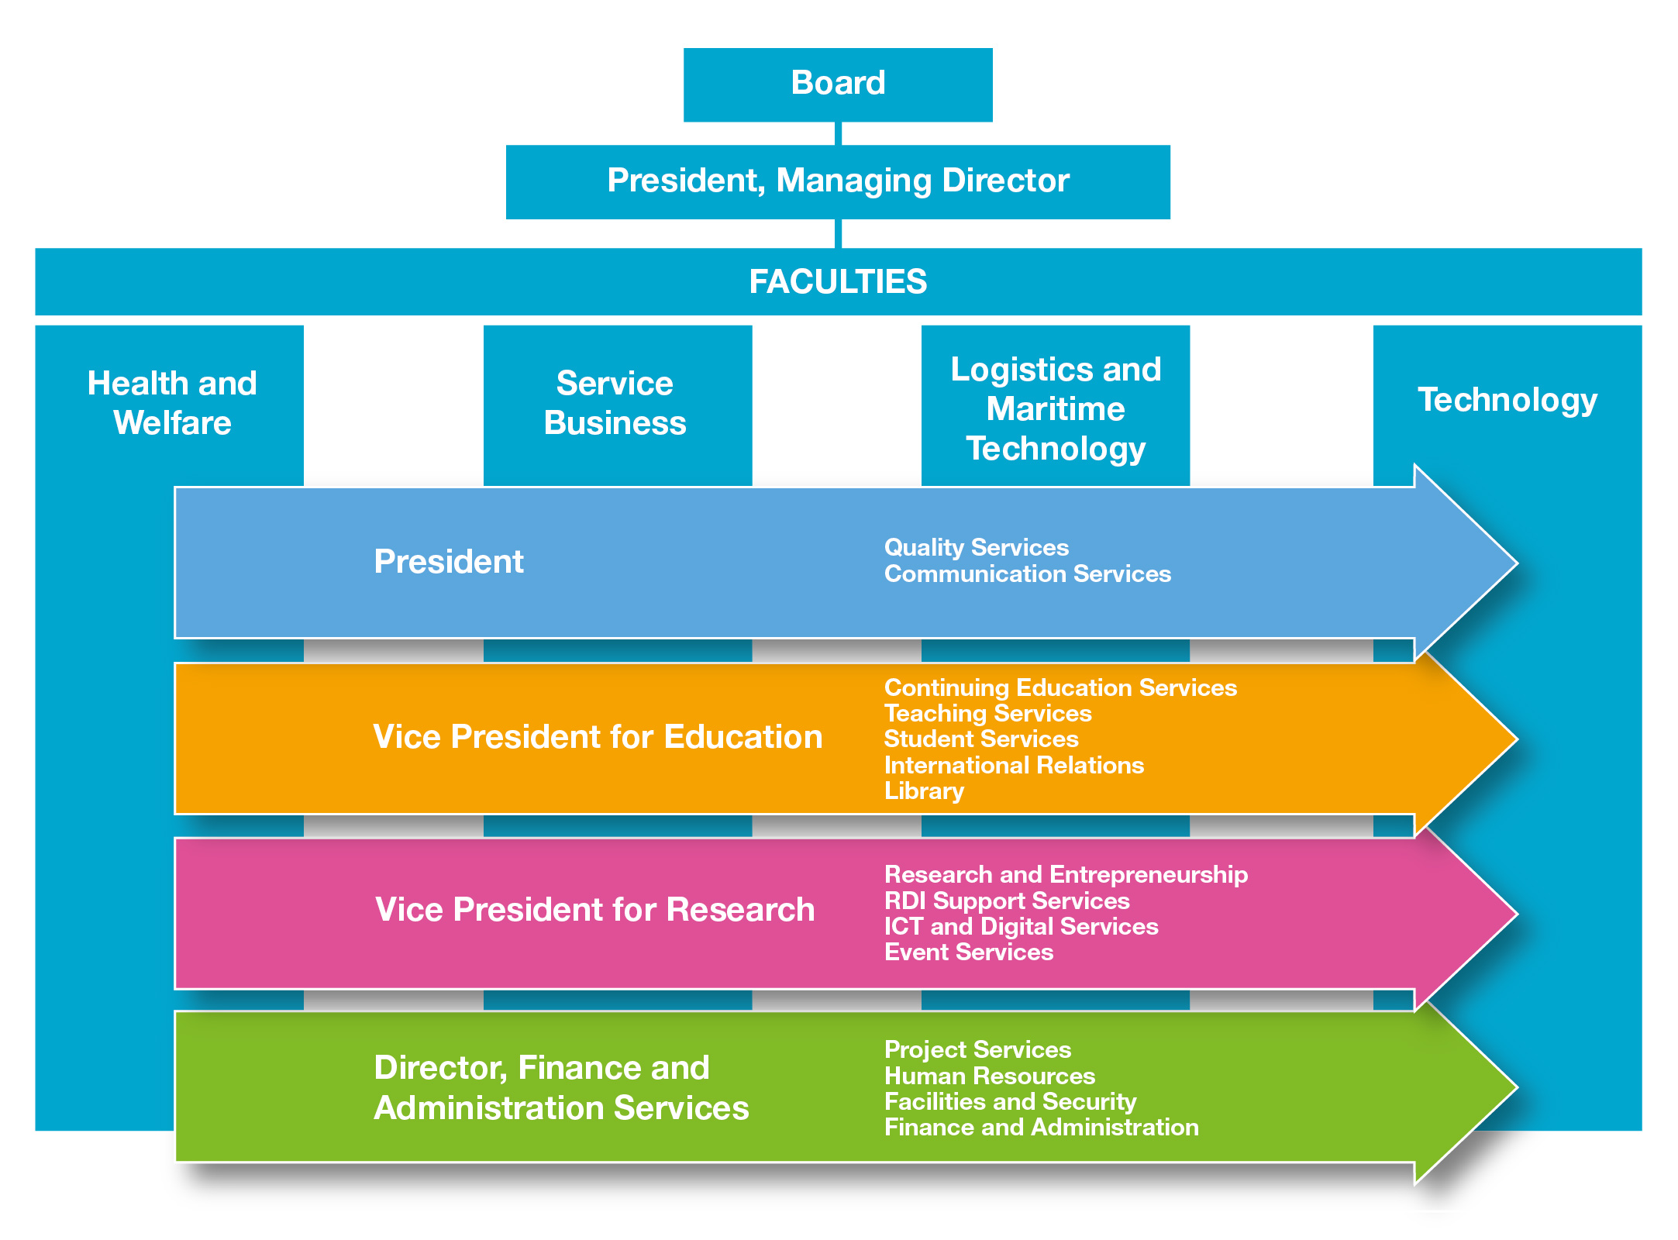

Slide 6
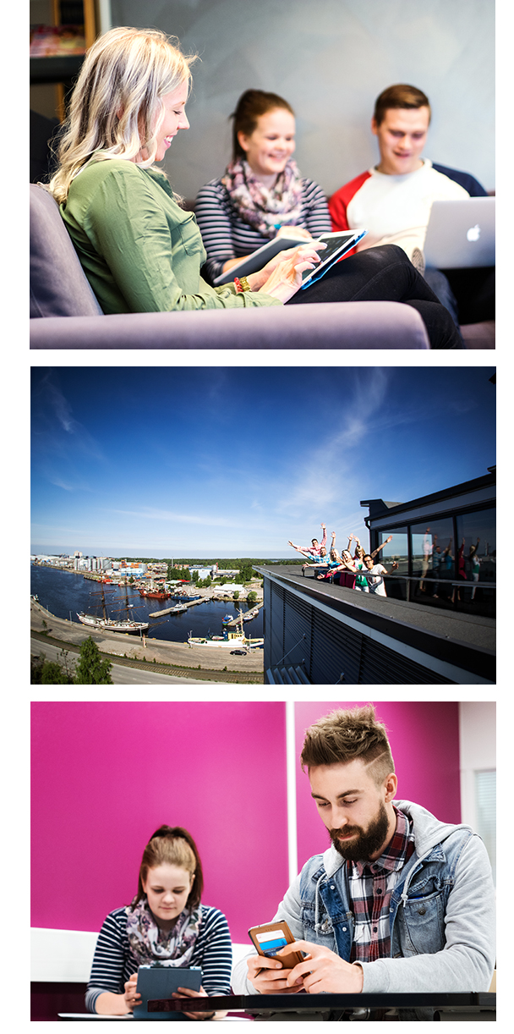
Excellent facilities IN MODERN CAMPUSES
Simulation Centres, e.g. Maritime, Nursing
Academies
  Robotics Academy
  Artificial Intelligence Academy
  Electric Academy
  Business and Technology Academy
WANDER Nordic Water and Materials Institute
SAMK EduTravel
Soteekki, service centre of social and health care
Enterprise Accelerator
HILL online lecture and e-learning environment
SAMK Library

Slide 7



TUITION & EMPLOYMENT
Best quality in tuition
  2009–2018 SAMK students have ranked us to be the number 1 in the quality of education (Ministry of Education AVOP Enquiry)
Best employment
  Number 1 when talking about the graduates’ employment among UAS’ outside the metropole area (Employment statistics by Statistics Finland).
Satisfied employers
  Less than 5% of the employers dissatisfied with the graduates’ competence (employer survey by SAMK)
Extensive company collaboration
  Entrepreneurs in Satakunta region have the largest experience in student collaboration
  They see SAMK increase the appeal of the region (National survey by the Federation of Finnish Enterprises)

Slide 8
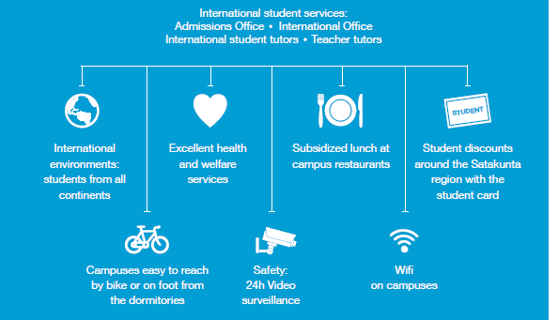
INTERNATIONAL student services

Slide 9
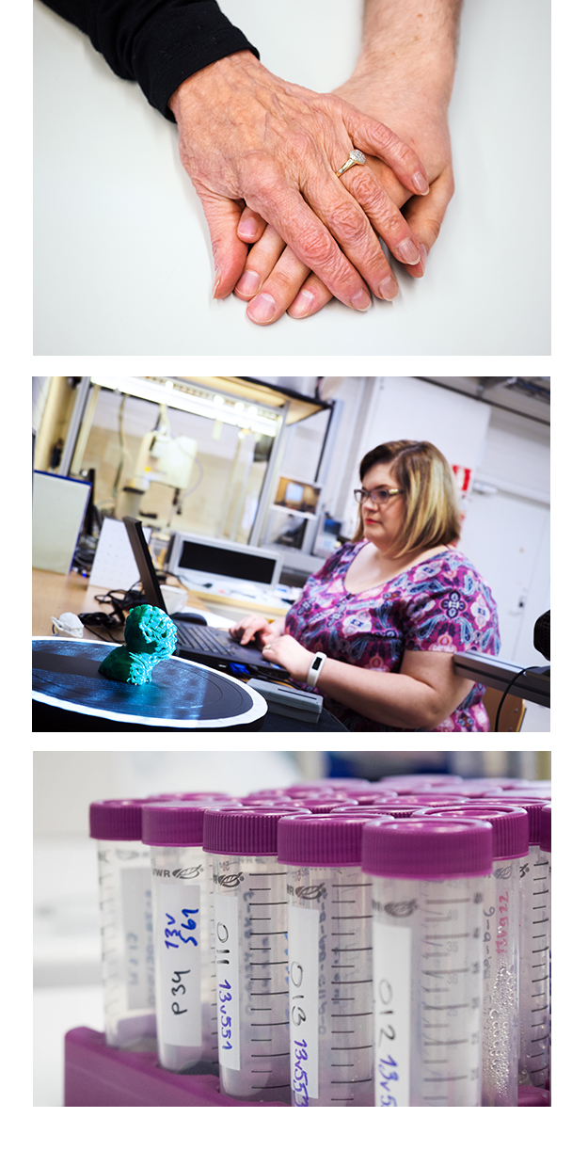
Research Groups
Automation
Accessibility
Enhancing the Functioning of the Work Force
Indoor Environment
Logistics
Mental Health
Services for the Ageing
Smart Energy Solutions
Smart Urban Business
Tourism Business
Well-Being Enhancing Technology
We aim to rapid utilizations of the research results.
Senior Fellows enhance the quality of SAMK's applied research and continuing education.

Slide 10
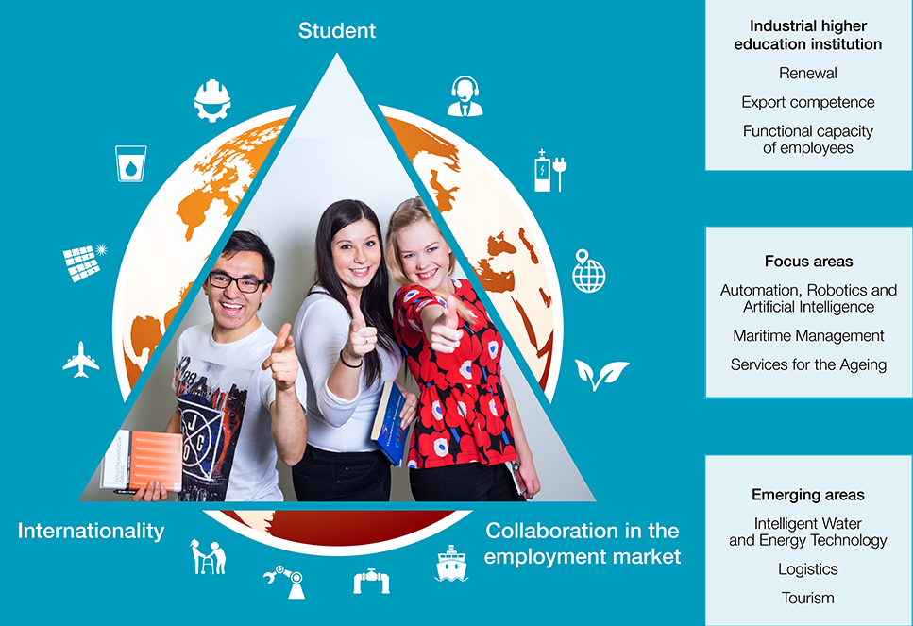
VISION: All SAMK students will be employed

Slide 11
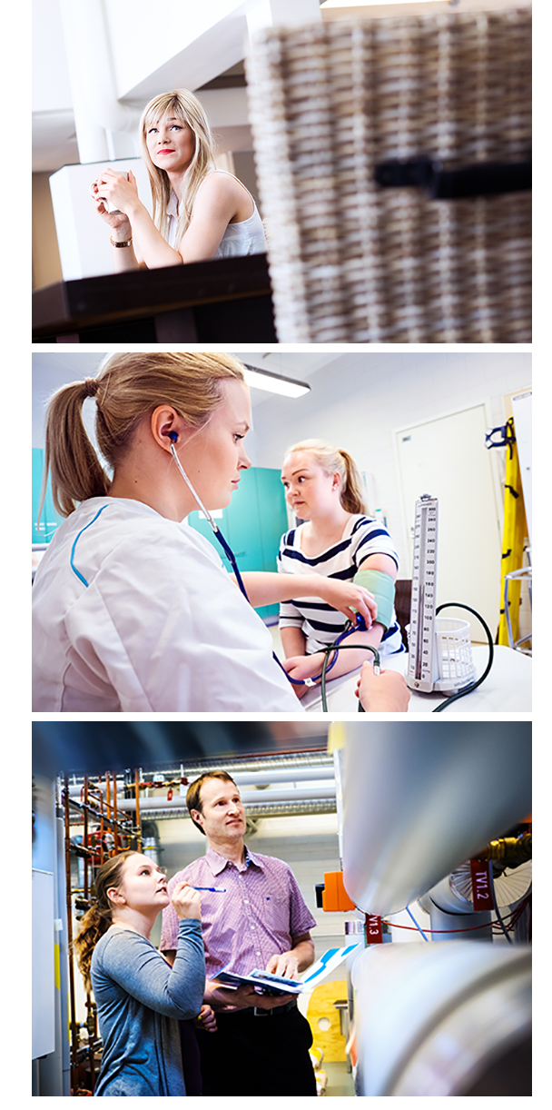

Bachelor’s Degrees in English
Artificial Intelligence (AI)
Industrial Management
International Business
International Tourism Development
Logistics
Nursing
Physiotherapy
Robotics
Sea Captain

Slide 12
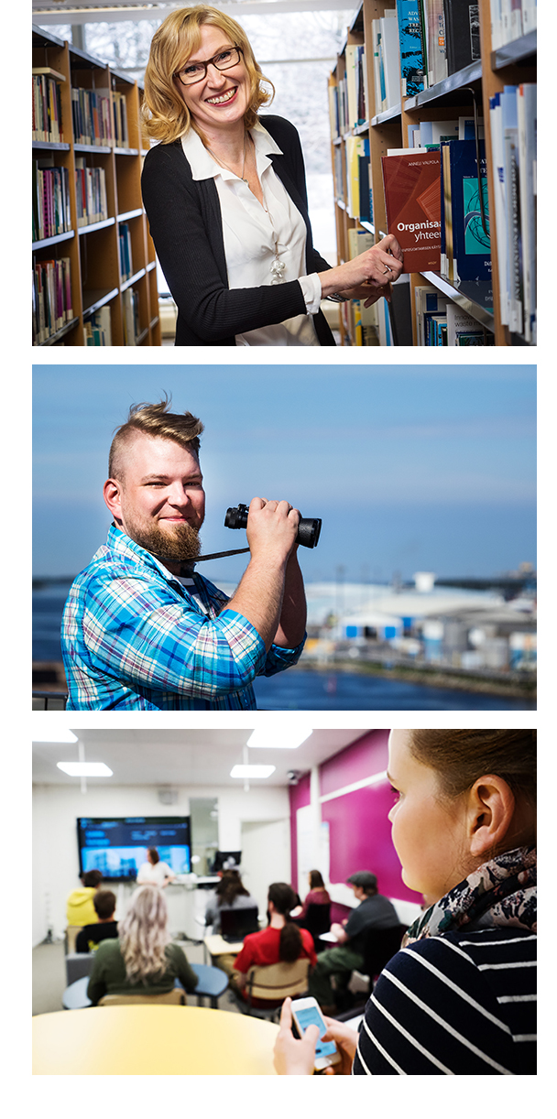

Master’s Degrees in English
Business Management and Entrepreneurship
Maritime Management
Rehabilitation
Welfare Technology
Tourism Management (2021)
Our business degree programmes in English have a NIBS International Accreditation.

Slide 13
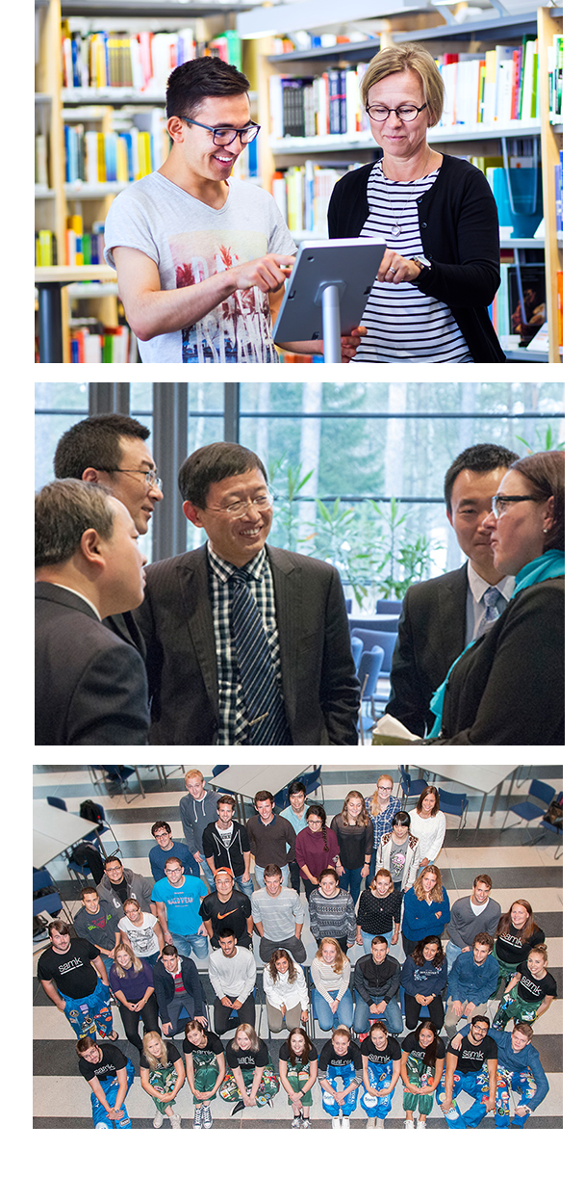
International Relations
Student and staff mobility
Co-operation agreements with over 200 institutions in four continents
Curricula-level co-operation
International networks
”China Campus”

Slide 14
VALUES
We are productive together.
We encourage intellectual curiosity.
We inspire responsibility.
We want to exceed expectations.

Slide 15
Contact information
+358 2 620 3000 | samk.fi/en

