Slide 1

Satakunta University of Applied Sciences
#OurSAMK

Slide 2
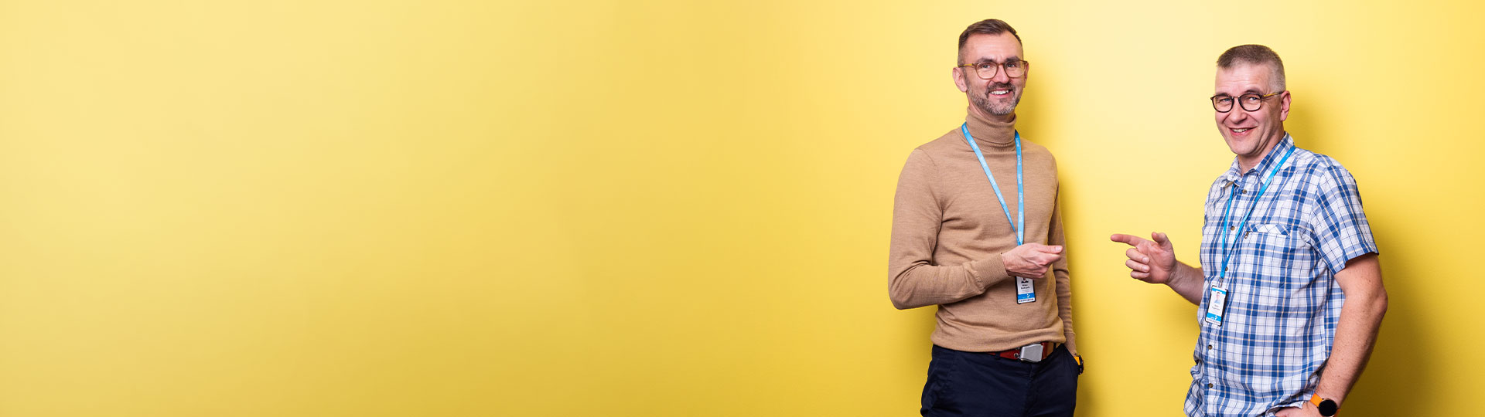
SAMK in figures
What is SAMK?
Figures for 2025
Degree
programmes
36
Degree
students
7,913
Staff
526
International
students
1,186

Slide 3
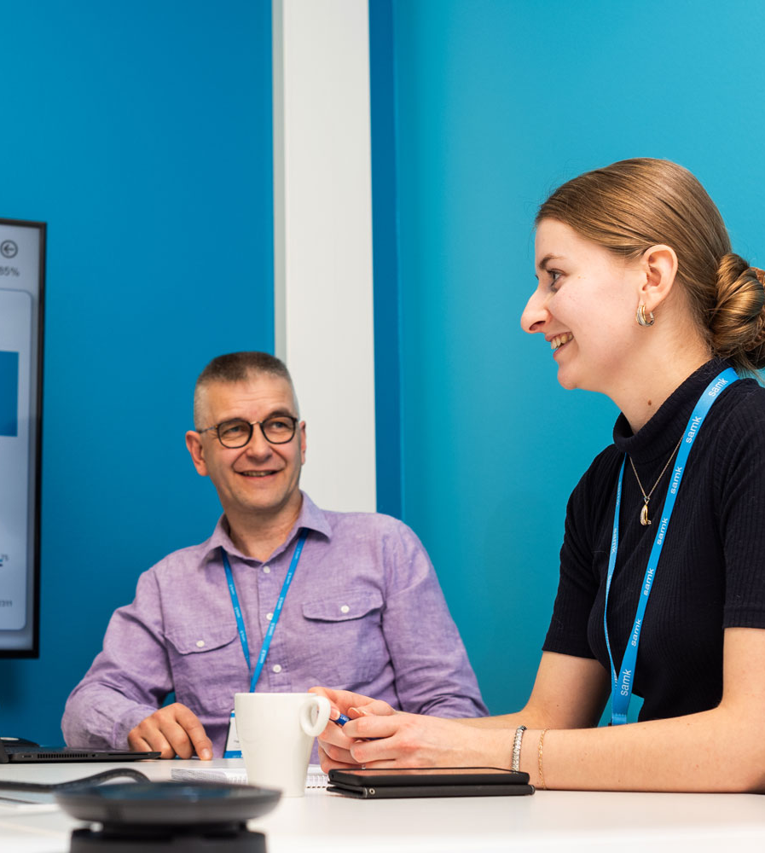
Multidisciplinary university
What is SAMK?
SAMK is a multidisciplinary and internationally oriented higher education institution on the west coast of Finland.
We educate professionals, drive development and internationalisation, and promote entrepreneurship.

Slide 4
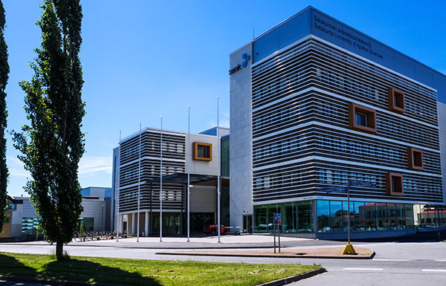
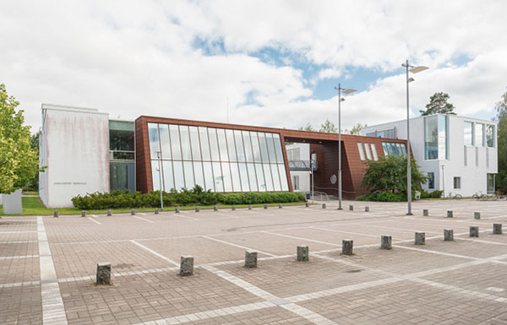
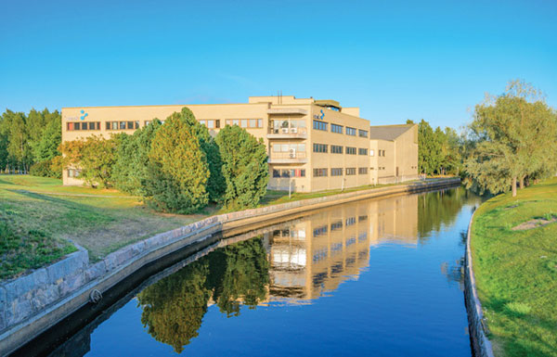
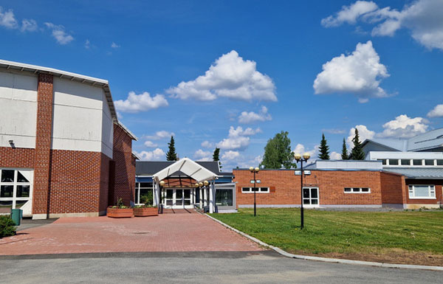
SAMK campuses
What is SAMK?
Pori
Kankaanpää
Rauma
Huittinen

Slide 5

Every SAMK student ​ graduates and finds employment​
What is SAMK?
Our vision
Our Profile
People and renewing industry.
Finland thrives on the industry of Satakunta and the West Coast. People play an important role in a renewing industry. With skilled workers and new technologies, we achieve our common goals.
Our mission
We educate professionals, drive development and internationalization and promote entrepreneurship.
The economic and industrial structure of the Satakunta region requires us to provide extensive and multidisciplinary education and research.

Slide 6
Finland succeeds when Satakunta succeeds. Satakunta succeeds when
SAMK succeeds. We succeed together.
What is SAMK?
We make dreams come true.
#OurSAMK

Slide 7

SAMK’s impact
What is SAMK?
Projects
130 ongoing projects,
with a total value of 24 million euros
Internationalisation
1,186 international students annually
Collaboration
Nearly 700 companies and organisations involved in collaboration

Slide 8
This is how we succeed
What is SAMK?
High-quality teaching
SAMK has been ranked among the universities of applied sciences offering the highest quality teaching (OKM AVOP).
Satisfied employers
Over 95 per cent of employers are satisfied with SAMK graduates’ competence (SAMK).
Extensive collaboration with companies
Entrepreneurs in the Satakunta region have the most experience with student collaboration; they see SAMK as a factor that boosts the region’s appeal (Federation of Finnish Enterprises; Suomen Yrittäjät).
Excellent employment rates
SAMK graduates are among the best-employed graduates from universities of applied sciences outside the Helsinki metropolitan area (Statistics Finland, 10-year statistical average).

Slide 9

Sustainability and responsiblity
What is SAMK?
We operate in an economically, ecologically, socially and culturally sustainable and responsible way.
We have been working long-term and with determination to promote sustainable development for over a decade.
We educate experts who promote sustainable development, and our RDI activities generate solutions to sustainability challenges.
‘Diverse SAMK’ serves as an umbrella concept for issues related to non-discrimination, inclusion, equality, and accessibility.

Slide 10

Principles of a safer space​
What is SAMK?
At SAMK, we treat one another with respect and as equals, and we listen to different points of view.
Respect
We don't assume others’ backgrounds or identities, and we give everyone space to be themselves and set their own boundaries. ​
Responsibility
Disrespectful, discriminatory or disruptive behaviour is not tolerated and will always be addressed in accordance with SAMK’s code of conduct. ​
Shared responsibility
We take accessibility into account and share responsibility for creating a safe and open atmosphere.

Slide 11


International higher education institution
What is SAMK?
Figures for 2025
Our doors are open to the world, and we are part of the European higher education community.
International students on our campuses, along with work placements and student exchanges worldwide, help develop the skills needed in the region’s working life. At the same time, SAMK’s international outlook strengthens Satakunta's and Finland's overall expertise and competitiveness.
Nationalities on campus
around 80
Students on exchange and international work placements each year
over 240
International students on campus
1,186
International partner universities
over 200

Slide 12
Work-oriented education
SAMK for students
SAMK makes dreams – big and small – come true.
Bachelor’s degrees
Master’s degrees
(Master School)
Open University of Applied Sciences: individual courses, path studies and non-stop courses
Specialization studies and continuing education
Training programmes, courses and seminars

Slide 13
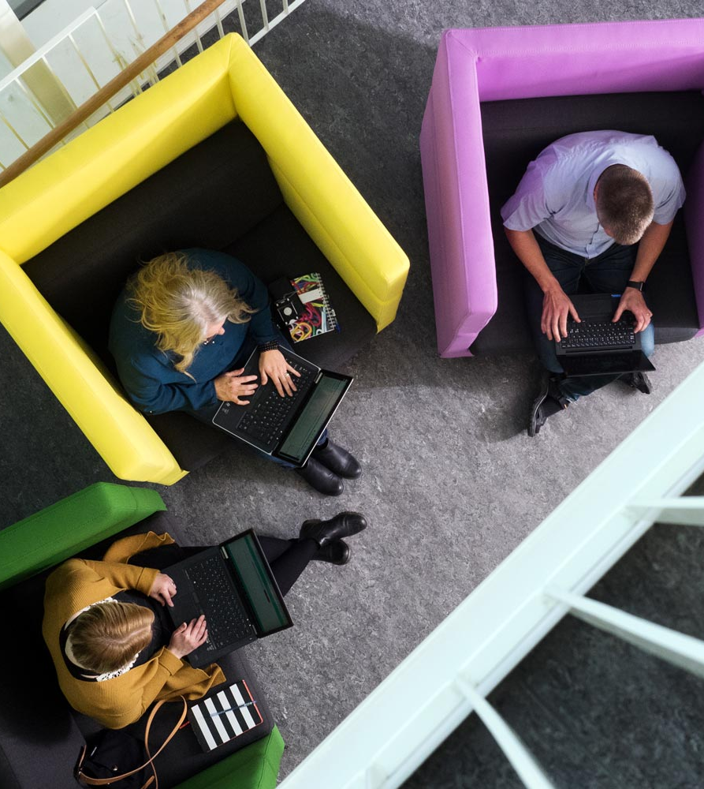
Top-quality teaching
SAMK for students
SAMK has been ranked amongst the universities of applied sciences offering the highest quality teaching.
In 2025, SAMK was among the best
in internationalisation
in teaching
in study planning, guidance and counselling.​

Slide 14
SAMK’s fields of study
SAMK for students
Eight fields of study provide expertise for various fields
Business
Engineerig
Health and welfare
Information
technology
Tourism

Slide 15
Degree programmes in English
For SAMK students
Bachelor's Degrees:
Artificial Intelligence (Data Engineering)
International Business
International Tourism Management
Logistics
Mechanical Engineering
Nursing
Physiotherapy
Robotics
Master's Degrees:
Business Administration
Master of Hospitality Management

Slide 16
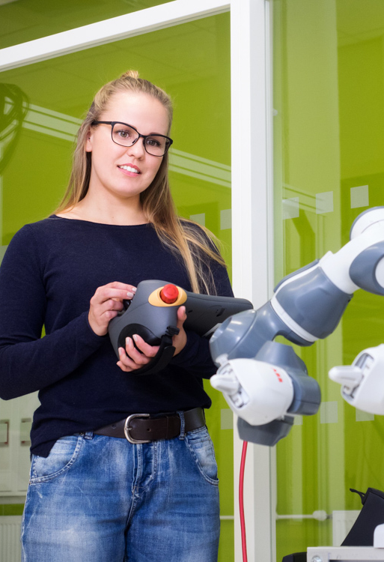
Practical learning
SAMK for students
Education is built around practical learning and collaboration with companies, bringing together the needs of education, RDI and working life through hands-on activities. ​
Problem-solving: Students get to solve real-world problems by applying theory to practice. ​
Laboratories and simulations serve as shared learning and development environments.​

Slide 17
Focus on student well-being
SAMK for students
Comprehensive support for students: We offer comprehensive services for students' well-being, smoother everyday life and progress in their studies.
Proactive approach: The CampusMoWe enables students and staff to benefit from a wide range of affordable and open sports and wellness services that promote both physical and mental well-being. We organize annual events, activities and services that enhance well-being and sense of community on all SAMK campuses.
Strengthening sense of community: We are building a safe and inclusive student community that supports well-being and fosters engagement with studies.
Supporting students in their everyday life: We provide flexible study paths, provide a functional study environment, and offer guidance for managing challenging life situations.

Slide 18
Business Accelerator
SAMK for students
Figures for 2025
SAMK Business Accelerator™ supports the creation, growth and renewal of new businesses.
Mentoring to help you get started, support for growth and funding for a good business idea
The services are available to all new and growing businesses in Satakunta​
New contracts
41
New businesses
8
Total contracts
884
Total number of businesses
410

Slide 19
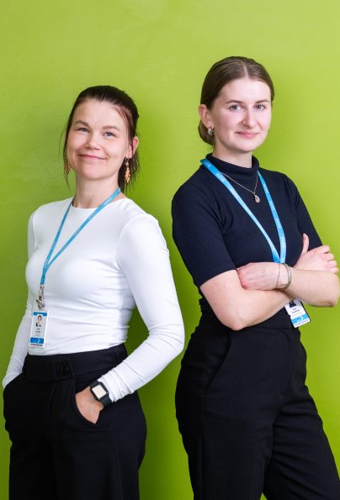
Solutions for the needs of working life
SAMK for stakeholders
SAMK acts as an active partner to the working life, public sector organizations and society.
SAMK offers companies and organizations training, expertise, talent, development environments and partnerships.
Partner companies and organisations
around 700

Slide 20

Work placements and theses
SAMK for stakeholders
Skills and solutions for the working life
Work placements
At SAMK, students learn in and for working life. During their work placements, students gain guided experience of key practical tasks in their own field and apply their skills in real-world work environments.
Theses
Theses are carried out in close collaboration with working life. Through research-based and applied theses, students develop practices and solve practical challenges arising from working life.

Slide 21
Impactful and diverse research
SAMK for stakeholders
SAMK is the driving force in regional collaboration between working life, education and research, and a leader in innovation and development networks. ​
Research builds expertise
Research strengthens expertise that can be directly transferred to teaching, students and the region’s working life.
Investment in research
As an industry-focused higher education institution, we invest in research that supports the renewal of industry and in strengthening the work ability of the regional workforce.
Innovation activities
We engage in open innovation activities, with the aim of transferring the results of RDI activities as effectively as possible for the benefit of stakeholders and partners.

Slide 22

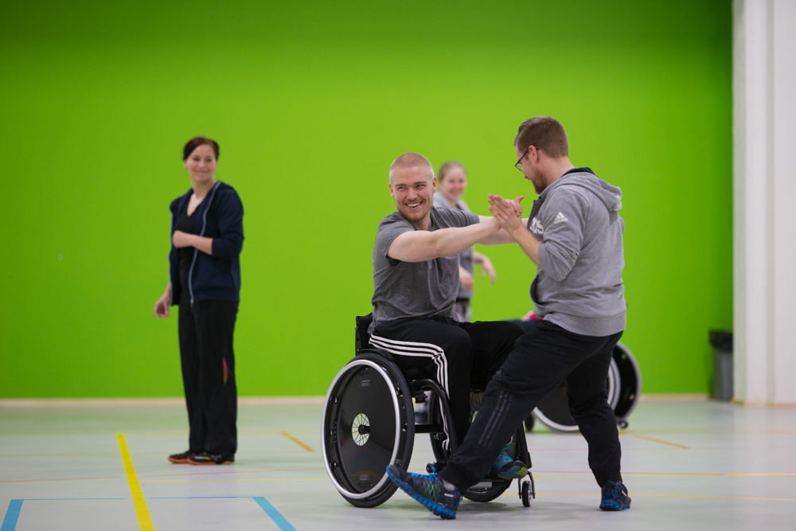
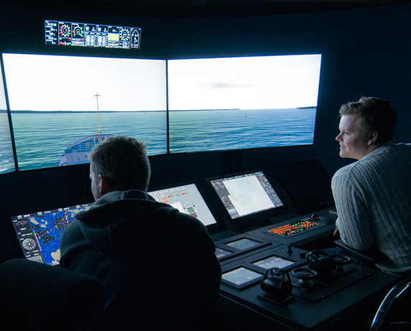
Research centers
SAMK for stakeholders
Business Intelligence Center
Center of Expertise in Resource Wisdom
Center for Tourism Business Development
Maritime Logistics Research Center
Research Center for Human Functioning
Research Center WANDER
RoboAI Research Center

Slide 23

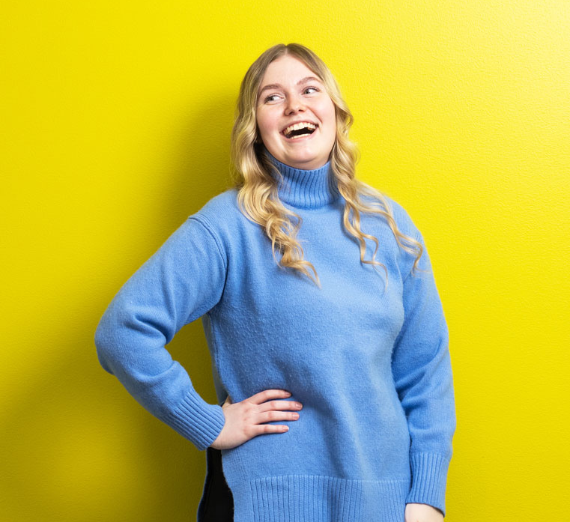
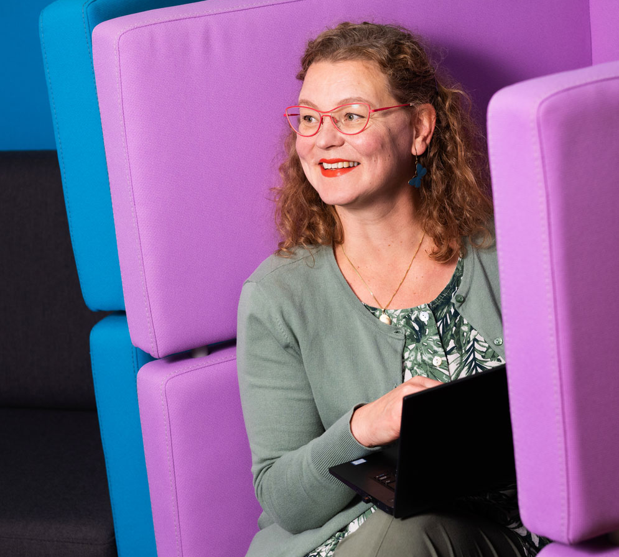
Projects
SAMK for stakeholders
Figures for 2025
Ongoing projects
130
Total project value
€24 million
New projects
External funding
€7.1 million
external funding in accordance with the funding model: €6.8 million
39
domestic
7
international

Slide 24

Publications raise the profile of research
SAMK for stakeholders
SAMK’s publications make the results of research and development work openly available to the working life and society.​
Our experts produce studies, reports, learning materials, videos and other publications as part of research and development projects and in teaching.​
The SAMK Research online journal showcases the research work of SAMK’s staff and research centres.
Total publications (June 2026)
254

Slide 25
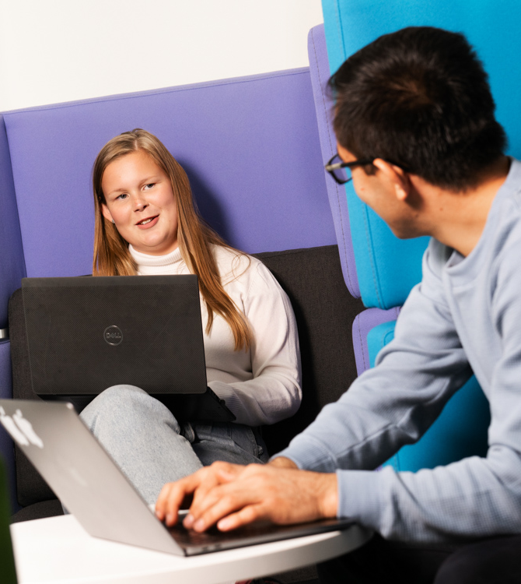
Impact through collaboration​
SAMK for stakeholders
SAMK is actively involved in multidisciplinary collaboration networks that support regional vitality, education, research and internationalization. ​
Strategic collaboration covers, amongst other things, quality development, cross-institutional studies, and research and innovation activities.

Slide 26

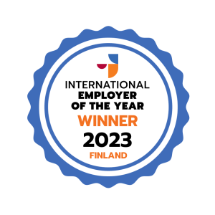
Award-winning international community
SAMK for stakeholders
SAMK is a member of the DIVERSE Alliance, a network of 12 European higher education institutions.
The European Commission has awarded the alliance the Seal of Excellence.
SAMK was named International Employer of the Year in 2023 for its successful recruitment and retention of international talent.

Slide 27
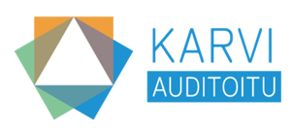
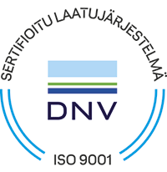
High-quality SAMK
SAMK for stakeholders
Quality is the foundation of our operations and our continuous development.
High-quality and effective operations require a university of applied sciences to continuously develop its activities and assess their impact.
Quality is evident in our day-to-day operations. Through our quality system, we also communicate our commitment to reliable operations to the outside world.
Quality labels and certificates
The Finnish Education Evaluation Centre (Karvi) has audited SAMK.
SAMK also holds an ISO 9001:2015 compliant certificate issued by DNV Business Assurance Management System Certificate.

Slide 28
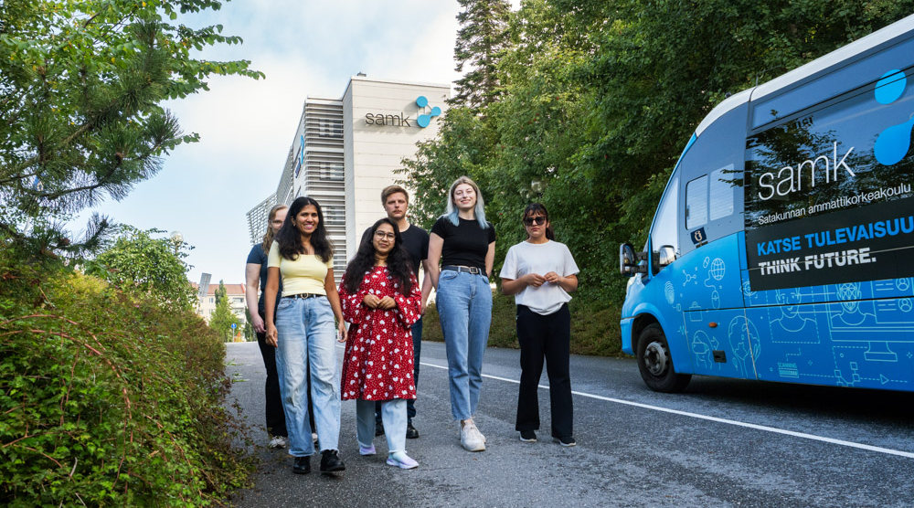
Ask about SAMK

Slide 29
samk.fi | #OurSAMK

