Slide 1
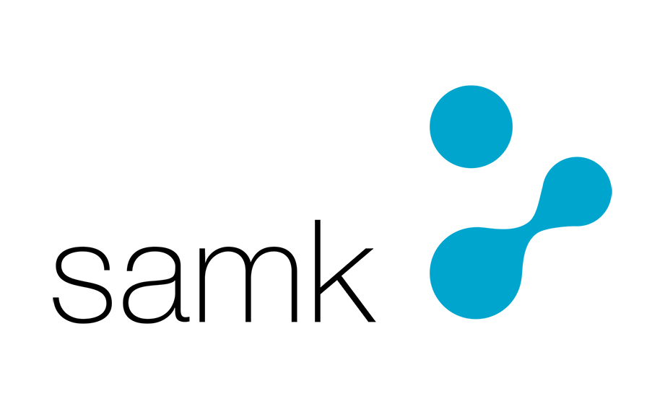
Our SAMK strategy
KATSE TULEVAISUUTEEN. | THINK FUTURE.

Slide 2
We make dreams come true:
Our job is to make dreams come true, no matter how big or small. Our work-oriented education enables each of our students to graduate and find employment.
Future growth stories are built around our core competences and faculties, around human welfare and modern industry.
Our doors are open to the world, and we are part of the European higher education community.
SAMK is a thriving higher education community of skilled people with its roots in Satakunta and its eyes on the future.
This is the Our SAMK strategy!

Slide 3
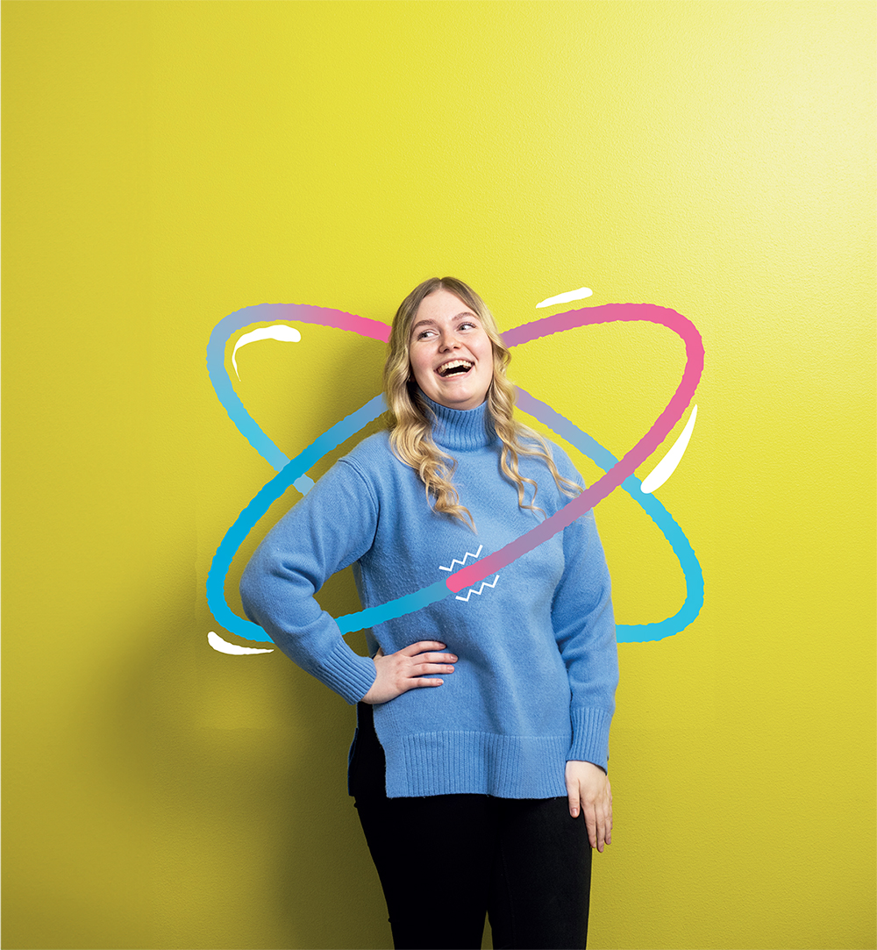



Our values
COMMUNITY
A thriving higher education community of skilled people is the foundation of our success. Together, we are building a people-centred culture that focuses on expertise, renewal, and open interaction.
RESPONSIBILITY
We operate in an economically, ecologically, socially and culturally sustainable and responsible way.
OPEN-MINDEDNESS
We want to learn new things constantly. We openly share our knowledge, based on experience and research. We boldly seek new ideas and perspectives.
Notes:
ARvot

Slide 4
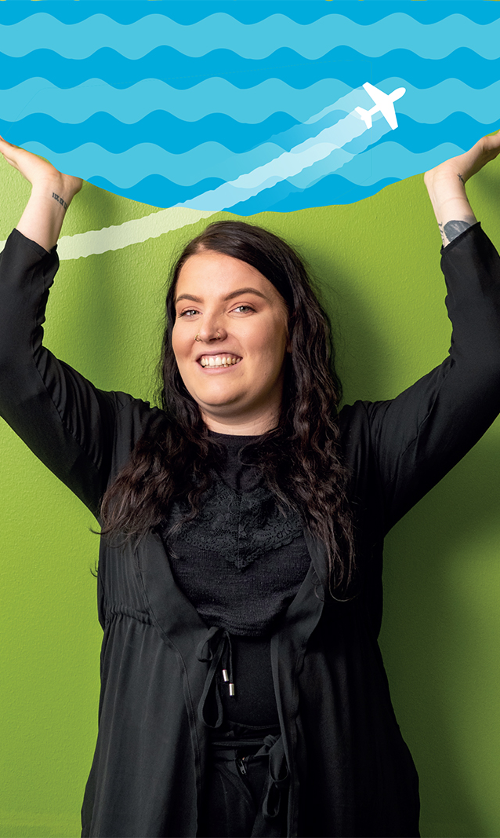


Every SAMK student graduates and finds employment
OUR VISION
Our mission
We educate, develop and internationalize, and we promote entrepreneurship. The economic and industrial structure of the Satakunta region requires us to provide extensive and multidisciplinary education and research opportunities.
Our profile
Finland depend on the industry of Satakunta and the West Coast. The role of people in a renewing industry is important. Skilled workers and new technologies help to achieve common goals.

Slide 5
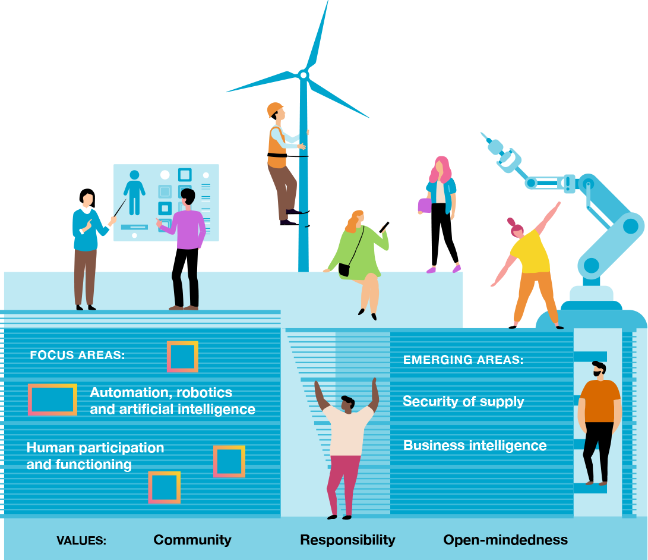
Our focus areas and emerging areas

Slide 6
Our strategic goals
Notes:
A thriving community
We are a skilled and thriving higher education community
A thriving higher education community of skilled people is the foundation of our success. Together, we are building a people-centred culture that focuses on expertise, renewal, and open interaction.
A strong sense of community is based on mutual respect and trust. Every member of our higher education community bears responsibility for the wellbeing of our community, supported by good leadership and teamwork.
Together, we create a safe and inspiring environment for staff, students and others in our higher education community.
We systematically and sustainably develop our skills and wellbeing. The joy of studying and working reinforces our attractiveness as a desirable place to study and work.
Sustainable and profitable operations
We act sustainably and profitably
We operate in an economically, ecologically, socially and culturally sustainable and responsible way.
We plan our operations so that they are financially sustainable in the long term. Every member of our higher education community bears responsibility for the success of our community.
Successful operations are based on successful student recruitment, the smooth progression and timely completion of studies, and the availability of needs-based continuous learning.
The profitability of our operations is underpinned by extensive international education and research. Our financial statements (adjusted by changes in the value of investments) are positive every year. Profitable operations and investment income allow for continuous development.
Working life needs
Work-oriented education and research
The economic and industrial structure of the Satakunta region requires us to provide extensive and multidisciplinary education and research opportunities. Regional cooperation based on active interaction between business and working life is at the heart of the education and research development.
We are responding to the changes in the region’s educational needs and the population projection by offering a diverse range of studying opportunities. We focus our training on degree programs that lead to graduation and employment.
With careful consideration, we will increase the number of students enrolled in multiform and online courses, as well as international degree courses, without increasing the number of degree students.
We will strengthen access to continuous learning by increasing flexibility and diversifying study opportunities. The Master School responds to the need to raise skills levels in the region and to the demand for continuous learning.
Identifying prior learning and accreditation are part of the smooth progression of studies. Work-oriented degrees and learning environments that support the Digivisio program visions ensure accessibility.
Internationalism
Our international students find jobs in Satakunta
Ensuring the availability of labour is the most important factor for the region’s vitality. As global migration rises, competition for talent is becoming fiercer. We will stabilize the number of international degree students. We integrate international students into Satakunta together with businesses and communities.
Research
Our research centers are part of the European higher education community
Researchers’ access to European cooperation will be strengthened by enhancing their scientific, business and EU funding skills. We are an active player in the European university network.

Slide 7
Our field of studies
  Fine Arts
  Business Administration
  Tourism and Hospitality Managament
  Maritime Management
  Technology and Business Information Systems
  Health and Welfare

Slide 8
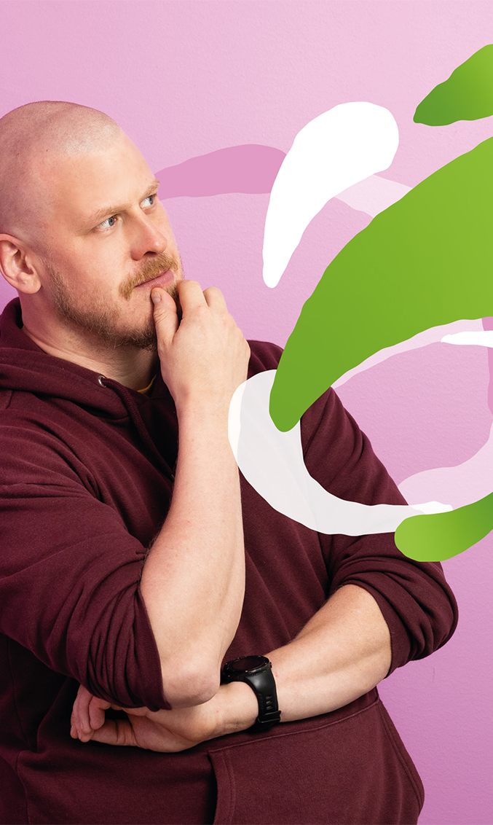
Our research centers
We invest in practical research activities to support industry, business and wellbeing services, especially in our region. Our research centers support companies in expanding and improving their business activities, as well as enhancing their competitiveness, efficiency and wellbeing at work.
  Business Intelligence Center BIC
  Center for Tourism Business Development
  Maritime Logistics Research Center
  Research Center for Human Functioning
  Research Center WANDER
  RoboAI Research and Development Center
In addition, we have a research entity for Resource Wisdom.

