Slide 1
Satakunta University of Applied Sciences
THINK FUTURE.
PRESENTATION | UPDATED JANUARY 2025

Slide 2

Personnel ca 530 Students ca 7 600
38 degree programmes
(of which 10 in English)
Additionally ca 4 400 / year within the Service of Continuing Education
Bachelor’s Degrees
Master’s Degrees
Open UAS
Educational services, courses, seminars

Slide 3

People and renewing industry
Research centers
Business Intelligence Center
Center for Tourism Business Development
Maritime Logistics Research Center
Research Center for Human Functioning
Research Center WANDER
RoboAI Research Center
Resource Wisdom

Slide 4
Satakunta is located on the west coast of Finland, in Northern Europe
SATAKUNTA
FINLAND

Slide 5
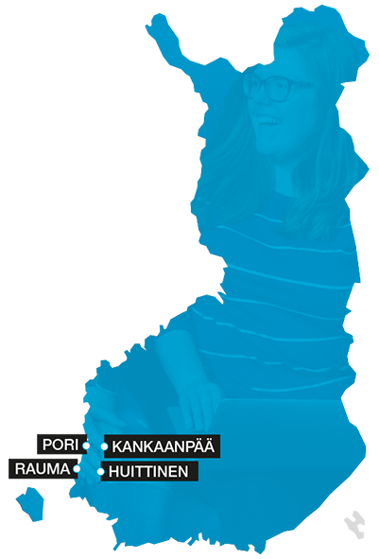
4 campuses and 4 towns
Pori
Rauma
Kankaanpää
Huittinen

Slide 6
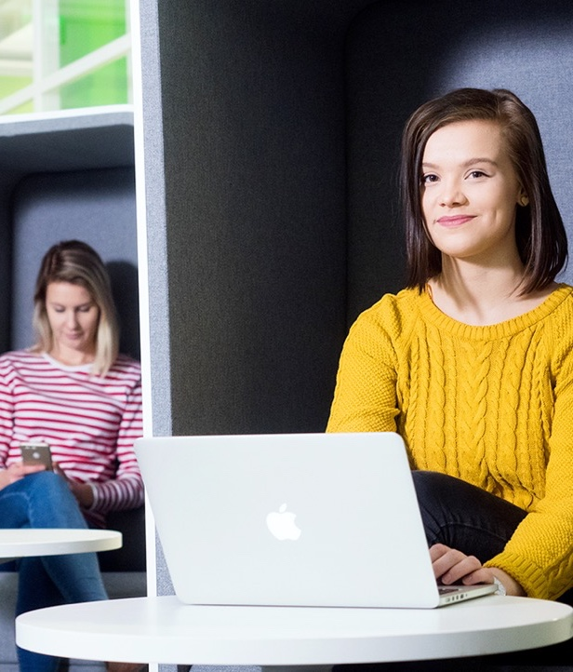
Key figures
Turnover EUR 45,9 M
Publications 226
Nationalities on campuses over 100
Ongoing projects 103
Total volume of projects EUR 23,05 M
Partner companies and communities ca 700
Notes:
Credits within continuing education 40 000+

Slide 7
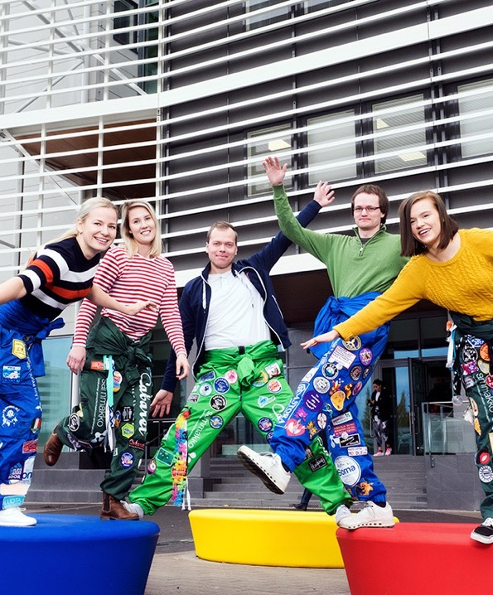
SAMK’s impact
Ca 50 % of graduates are employed in Satakunta (2023)
More than 1200 foreign students annually on average (more than 100 nationalities)
Almost 700 enterprises and communities in cooperation
37 new agreements were signed (843 in total) and 4 new companies were established (402 in total) in the Enterprise Accelerator (2024)
SAMK applies for over EUR 5 M of national and international funding for the region annually

Slide 8
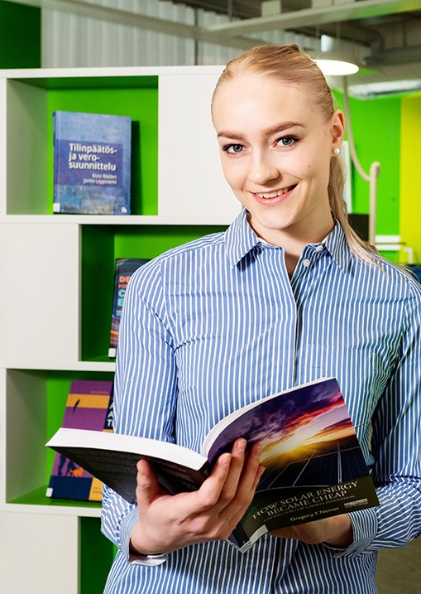
Strategy
MISSION
We educate, develop and internationalize, and we promote entrepreneurship. The economic and industrial structure of the Satakunta region requires us to provide extensive and multidisciplinary education and research opportunities.
OUR PROFILE: People and renewing industry
Finland depend on the industry of Satakunta and the West Coast. The role of people in a modernizing industry is important. Skilled workers and new technologies help to achieve common goals.

Slide 9
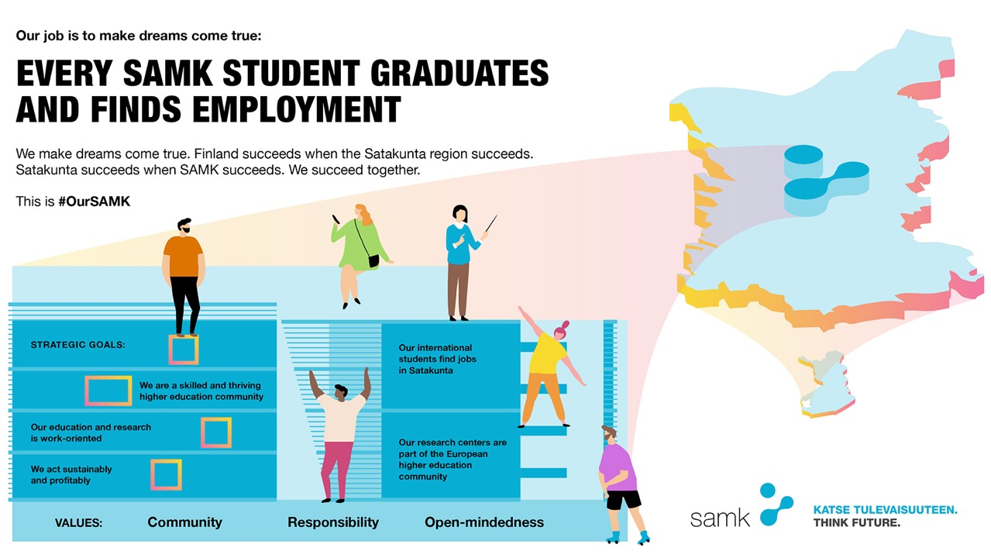
Towards the Our SAMK strategy (2025 onwards)
Notes:
A thriving community
We are a skilled and thriving higher education community
A thriving higher education community of skilled people is the foundation of our success. Together, we are building a people-centred culture that focuses on expertise, renewal, and open interaction.
A strong sense of community is based on mutual respect and trust. Every member of our higher education community bears responsibility for the wellbeing of our community, supported by good leadership and teamwork.
Together, we create a safe and inspiring environment for staff, students and others in our higher education community.
We systematically and sustainably develop our skills and wellbeing. The joy of studying and working reinforces our attractiveness as a desirable place to study and work.
Sustainable and profitable operations
We act sustainably and profitably
We operate in an economically, ecologically, socially and culturally sustainable and responsible way.
We plan our operations so that they are financially sustainable in the long term. Every member of our higher education community bears responsibility for the success of our community.
Successful operations are based on successful student recruitment, the smooth progression and timely completion of studies, and the availability of needs-based continuous learning.
The profitability of our operations is underpinned by extensive international education and research. Our financial statements (adjusted by changes in the value of investments) are positive every year. Profitable operations and investment income allow for continuous development.
Working life needs
Our work-oriented education and research
The economic and industrial structure of the Satakunta region requires us to provide extensive and multidisciplinary education and research opportunities. Regional cooperation based on active interaction between business and working life is at the heart of the education and research development.
We are responding to the changes in the region’s educational needs and the population projection by offering a diverse range of studying opportunities. We focus our training on degree programs that lead to graduation and employment.
With careful consideration, we will increase the number of students enrolled in multiform and online courses, as well as international degree courses, without increasing the number of degree students.
We will strengthen access to continuous learning by increasing flexibility and diversifying study opportunities. The Master School responds to the need to raise skills levels in the region and to the demand for continuous learning.
Identifying prior learning and accreditation are part of the smooth progression of studies. Work-oriented degrees and learning environments that support the Digivisio program visions ensure accessibility.
Internationalism
Our international students find jobs in Satakunta
Ensuring the availability of labour is the most important factor for the region’s vitality. As global migration rises, competition for talent is becoming fiercer. We will stabilize the number of international degree students. We integrate international students into Satakunta together with businesses and communities.
Research
Our research centers are part of the European higher education community
Researchers’ access to European cooperation will be strengthened by enhancing their scientific, business and EU funding skills. We are an active player in the European university network.

Slide 10
Focus on student well-being
COMPREHENSIVE SUPPORT FOR STUDENTS
We offer comprehensive services for students' well-being, smoother everyday life and progress in their studies.
STRENGTHENING SENSE OF COMMUNITY
We are building a safe and inclusive student community that supports well-being and fosters engagement with studies.
SUPPORTING STUDENTS IN THEIR EVERYDAY LIFE
We provide flexible study paths, provide a functional study environment, and offer guidance for managing challenging life situations.
PROACTIVE APPROACH
The CampusMoWe enables students and staff to benefit from a wide range of affordable and open sports and wellness services that promote both physical and mental well-being. We organize annual events, activities and services that enhance well-being and sense of community on all SAMK campuses.

Slide 11
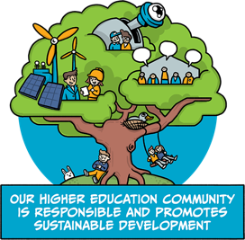
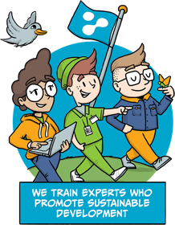
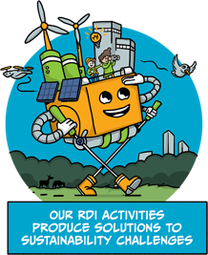

Sustainable Development and Responsibility
Notes:
HANDPRINT 1: Our higher education community is responsible and promotes sustainable development
HANDPRINT 2: We train experts who promote sustainable development
HANDPRINT 3: Our RDI activities produce solutions to sustainability challenges
FOOTPRINT: We will be a carbon-neutral university by 2030

Slide 12






High quality teaching
Excellent employment
SAMK has been rated among the highest quality universities of applied sciences (OKM AVOP).
SAMK graduates are among the best employed of all universities of applied sciences outside the Helsinki Metropolitan Area (Statistics Finland, ten-year statistical average)
Extensive cooperation with companies
Satisfied employers
Entrepreneurs in Satakunta region have the most experience in cooperating with students and see SAMK as an asset to raise attraction to the region (Federation of Finnish Enterprises)
More than 95% of employers satisfied with the competence of the graduated (SAMK)

Slide 13
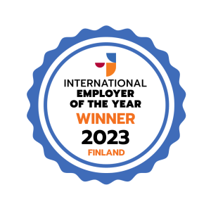

Award winning international community
Every year SAMK attracts over 1200 international degree and exchange students from more than 100 countries.
Around 200 partner universities all over the world.
In 2023 SAMK was awarded as the International Employer of the Year for successfully recruiting and retaining international talents.
SAMK, together with 11 other European higher education institutions, has formed the DIVERSE alliance of European universities. The European Commission has awarded the Seal of Excellence to the Alliance. This positions SAMK as part of the flagship collaboration of the Commission's European Strategy for Universities.

Slide 14
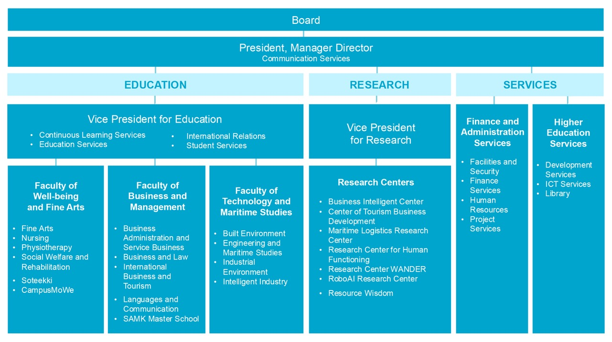

Slide 15
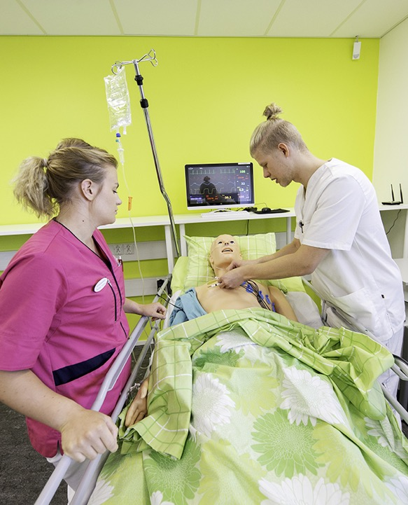
Bachelor’s Degree Programmes in Finnish
Fine Art
Fine Arts
Business
Business Administration
Entrepreneur’s Degree Programme
Maritime Management
Sea Captain
Technology
Construction and Municipal Engineering
Electrical and Automation Engineering
Energy and Environmental Engineering
Industrial Management
Information and communication Technology
Logistics
Marine Engineering
Mechanical Engineering
Production Engineering / Food Engineering

Slide 16

Bachelor’s Degree Programmes in Finnish
Welfare and Health
Elderly Care
Nursing
Physiotherapy
Rehabilitation Counselling
Social Services

Slide 17
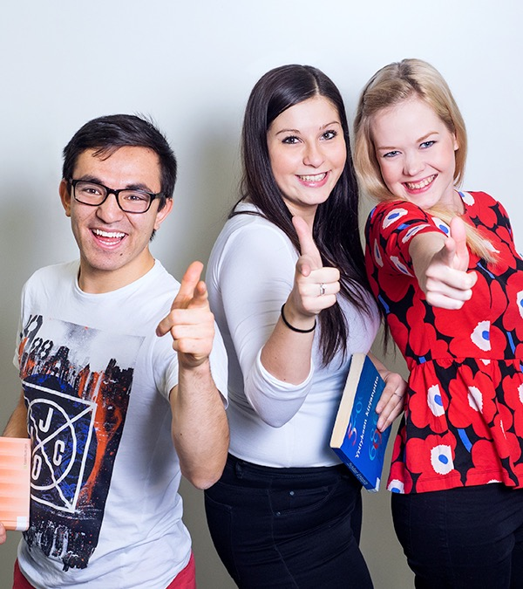
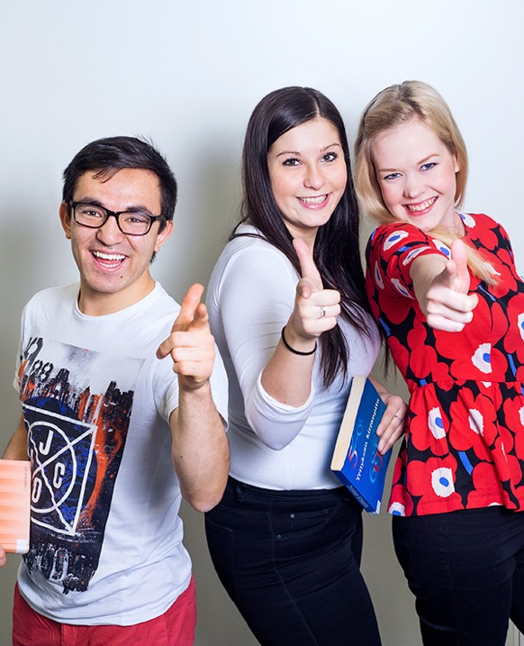


Bachelor’s Degree Programmes in English
Artificial Intelligence (AI)
International Business (NIBS accredited)
International Tourism Management
Logistics
Mechatronics
Mechanical Engineering
Nursing
Physiotherapy (WCPT accredited)

Slide 18
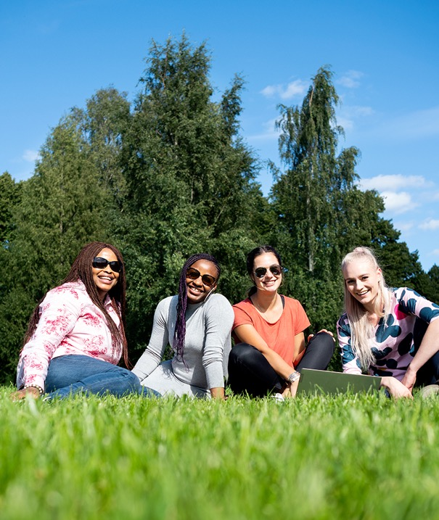


Master’s Degree Programmes in English
Sustainable Business Management
Tourism and Business Management
The English business education is accredited by NIBS

Slide 19
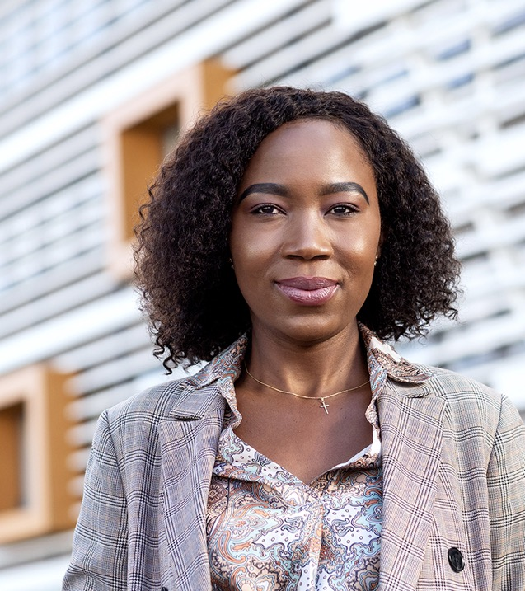
SAMK Master School
SAMK Master School brings together Master's degrees in Finnish and offers flexible, individual study paths that meet both personal and professional needs.
Degrees (in Finnish):
Responsible Supply Chain
Future Leadership
Technology
Renewing Expertise and Leadership in Well-being
Notes:
You can only apply for current YAMK degrees through a transfer application:Vastuullinen toimitusverkosto (YAMK)
Development and Management of Welfare Services
Elderly Care
Health and Welfare Promotion
Future Leadership
Social Services
Supply Chain Management
Technology
Welfare Technology

Slide 20
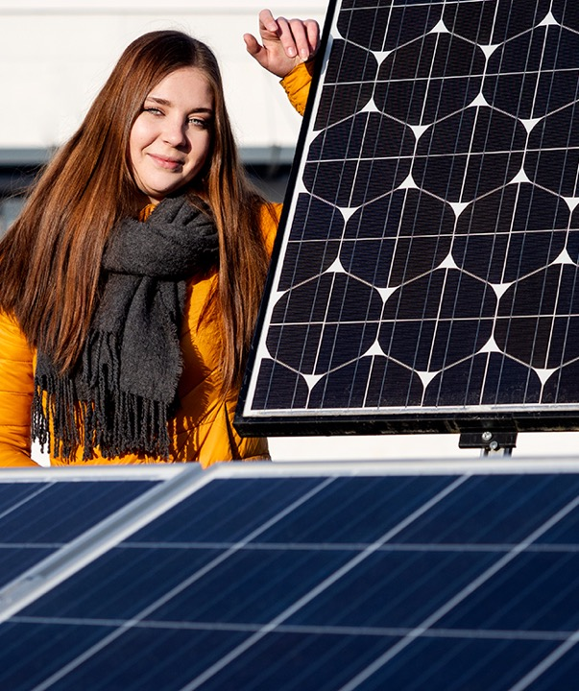
Research Centers
Business Intelligence Center
Center for Tourism Business Development
Maritime Logistics Research Center
Research Center for Human Functioning
Research Center WANDER
RoboAI Research Center
In addition, SAMK has the Resource Wisdom research area.

Slide 21

Business Intelligence Center
Supports companies in the process of transforming the data they own and collect into knowledge that can be used to support decision-making.
Creates tools and models for improving business efficiency, well-being and productivity – with the aim to enhance competitiveness.

Slide 22
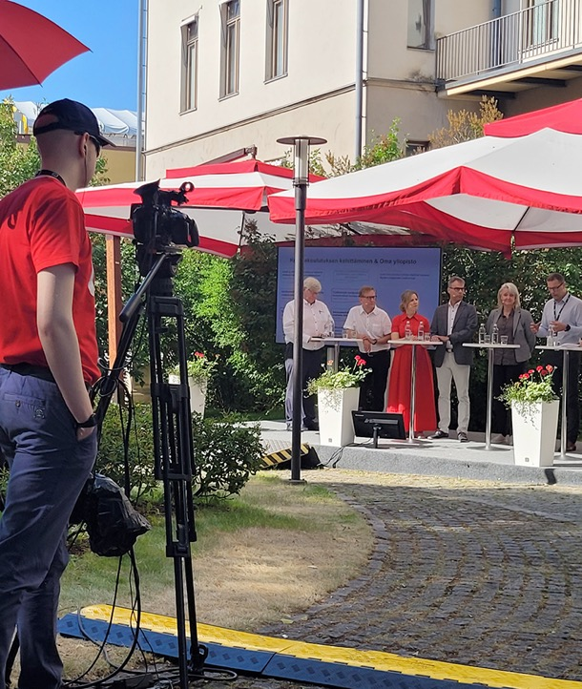
Center for Tourism Business Development
Leads tourism enterprises towards more sustainable, smart and profitable business.
Offers the tourism industry skills, information, tools, and networks to increase business competitiveness and renewal.

Slide 23
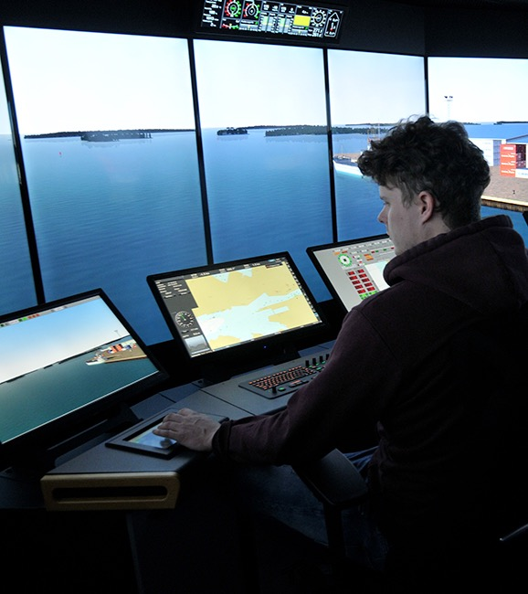
Maritime Logistics Research Center
Supports the growth and competitiveness of the enterprises in maritime technology and logistics in the Satakunta region.
Makes research infrastructure, high-quality research and international product development available for enterprises.

Slide 24
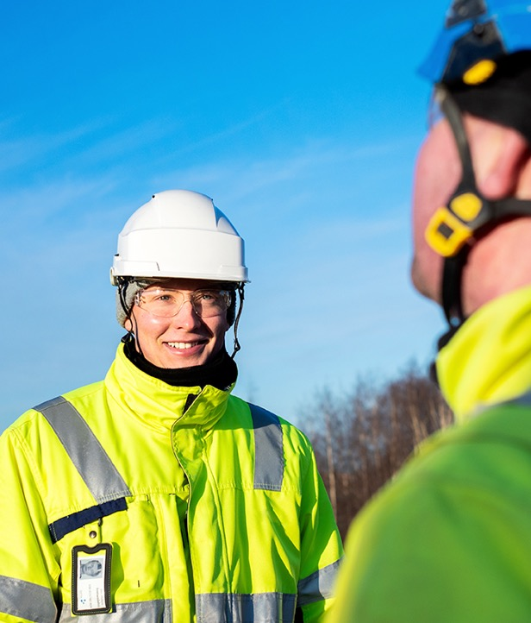
Research Center for Human Functioning
Helps people to cope in everyday life and work, and to look after themselves and others.
Addresses the challenge of labor shortage and well-being in Satakunta through research, education, and development work.

Slide 25

Research Center WANDER
Internationally distinguished research on water, materials in contact with water, antimicrobial coatings, indoor hygiene and hygiene building solutions.
Provides expert services on water and materials in contact with water.

Slide 26
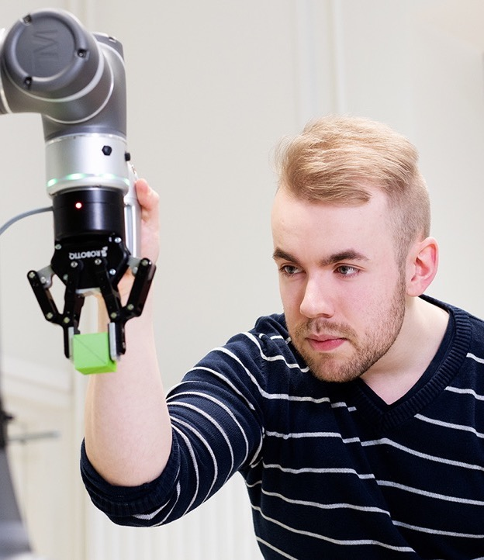
RoboAI Research Center
Supports the growth of industry and enterprices in the region, increases competitiveness and creates a strong basis for the digitalisation of industry and public services.
Provides research infrastructure, a laboratory, high-quality research and international product development available for the enterprises.

Slide 27
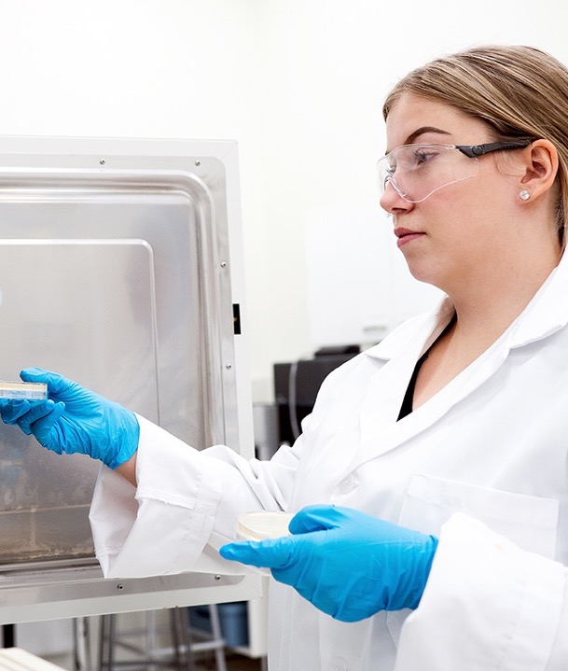
Operational learning and research environments
RoboAI Academy, Electric Academy, Artificial Intelligence Academy, Business and Technology Academy
Automation laboratory, Solar energy laboratory
Business and technology services – Apparaatti
Maritime simulator, Simulation environments for Health and Welfare
SAMK Enterprise Accelerator™
Soteekki, the service centre of social and health care

Slide 28
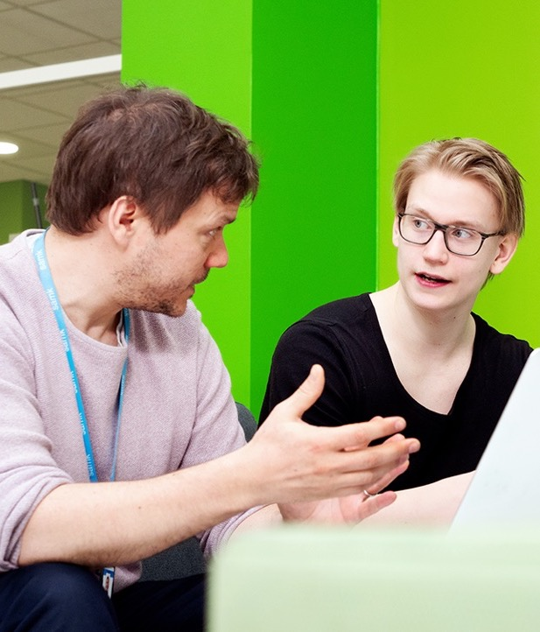
Enterprise Accelerator™
An educational quality unit among the universities of applied sciences, rewarded by the Ministry of Education and Culture.
In the Enterprise Accelerator, one can direct the studies for the benefit of one’s own business operations
Encouragement to start, support to grow
Funding for a good business idea
The services of SAMK’s Enterprise Accelerator are available for every start-up entrepreneur and any developing entrepreneur in Satakunta.

Slide 29
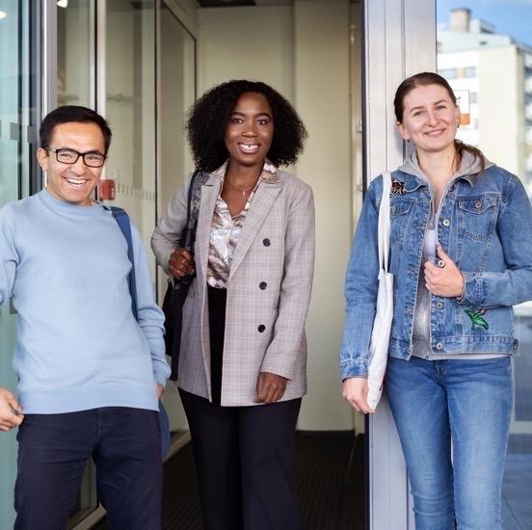
THINK FUTURE.

